Slide 1

Lightning Talks
Part II
BBSW 2019

Slide 2

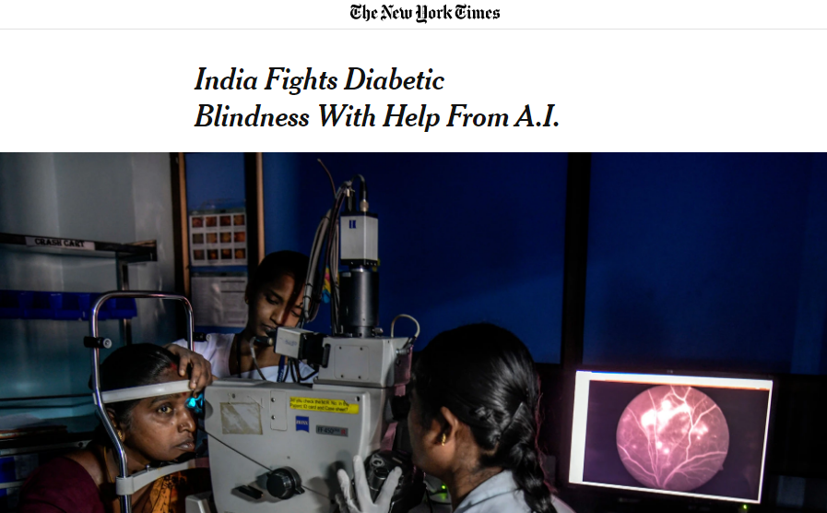

Approved product using deep learning

Slide 3
FDA’s Interests in Interactive Analysis Tools
Live demo of tools from Genentech in 2016 and 2018
PhUSE (Pharmaceuticals Users Software Exchange)
Emerging trends and technology working group
Pilot studies using real trial data
Safety analysis submitted July 2019 (Eli Lilly)
Supportive PRO analysis Q2 2020 (under assessment at Genentech)

Slide 4
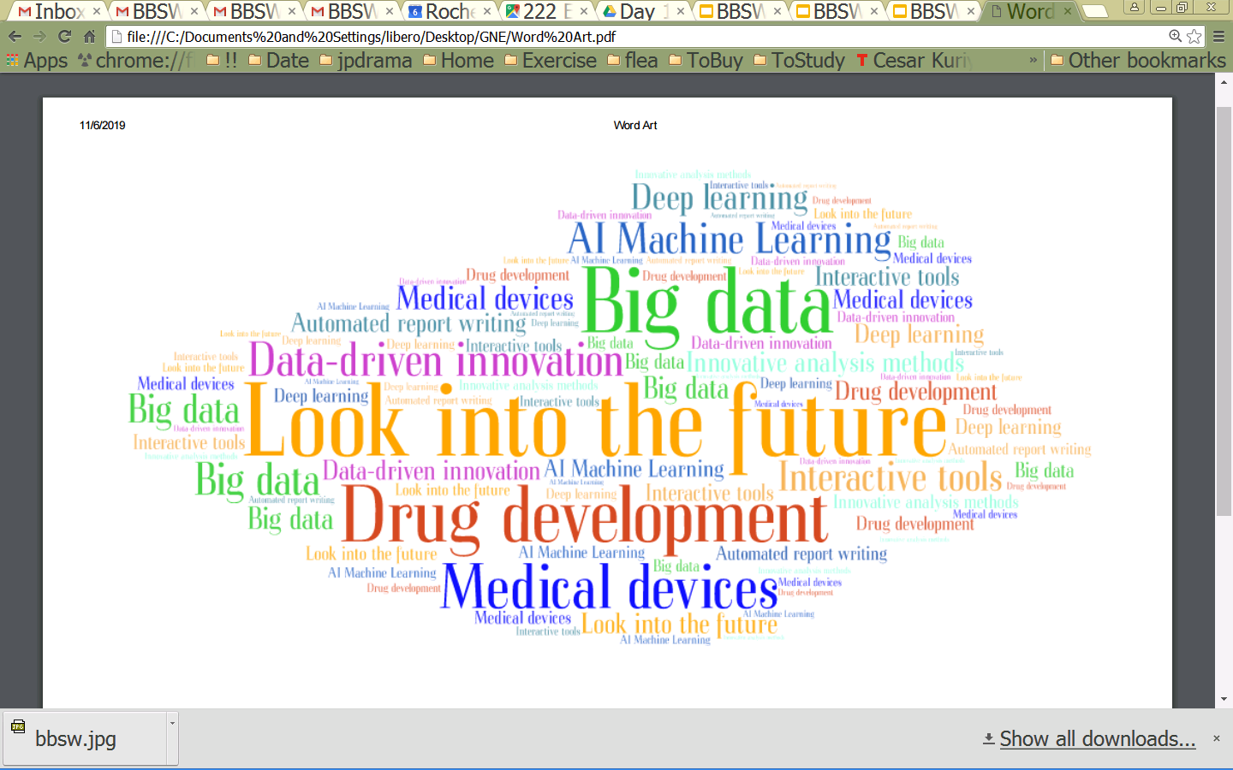
Share with us your cool stories in the future!
What’s in it for me?
What’s the impact on my daily work?

